Slide 1

Welcome to Year 4!
4M Turtles: Miss Wild
4R Barn Owls: Mrs Baucher-Webb
Miss McKee
Miss Rowe
Mr Lam
Miss Griffiths

Slide 2

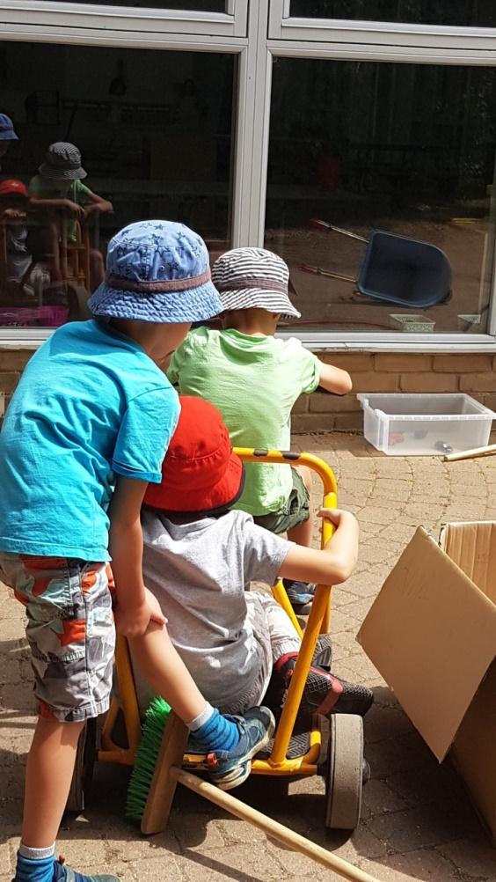
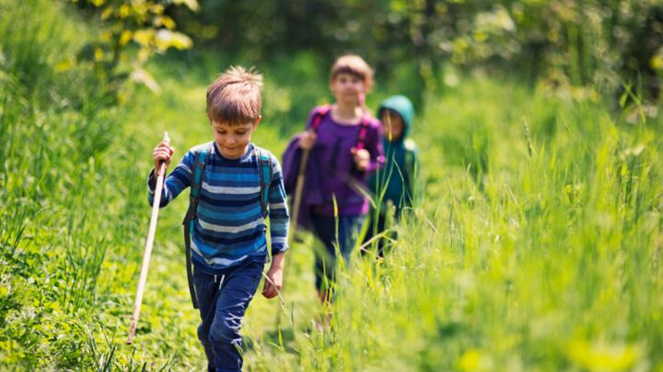

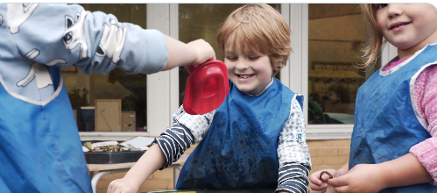
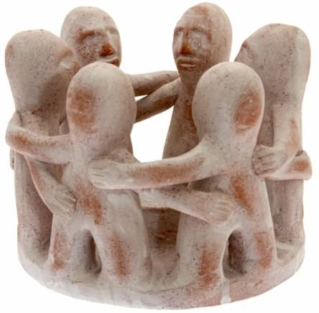
What’s our curriculum purpose?
We want our children to be happy & healthy today, fulfilled in the future and able to make their world an even better place.

Slide 3
We are a Values Based School - Values at the Heart of our Ethos
#WeAreCrew
C – Creativity, Curiosity, Kindness, Confidence, Care, Change making
R – Respect, Responsibility
E – Excellence, Elegance, Empathy
W – Wisdom

Slide 4
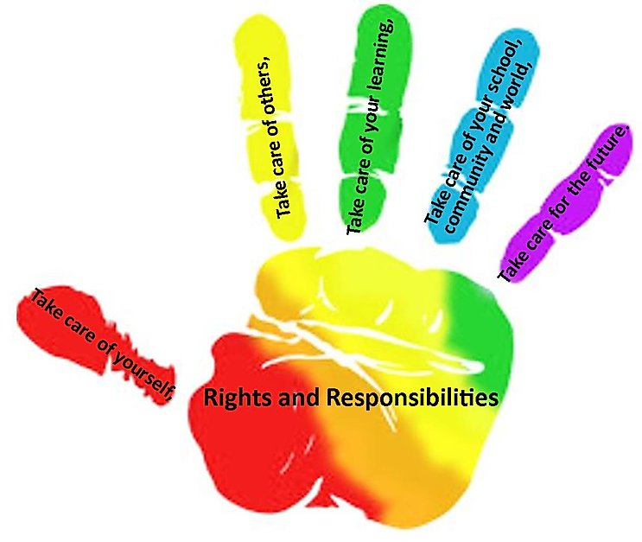
Safety, Well-being, Welfare
The Take Care Agreements to keep everyone safe!

Slide 5
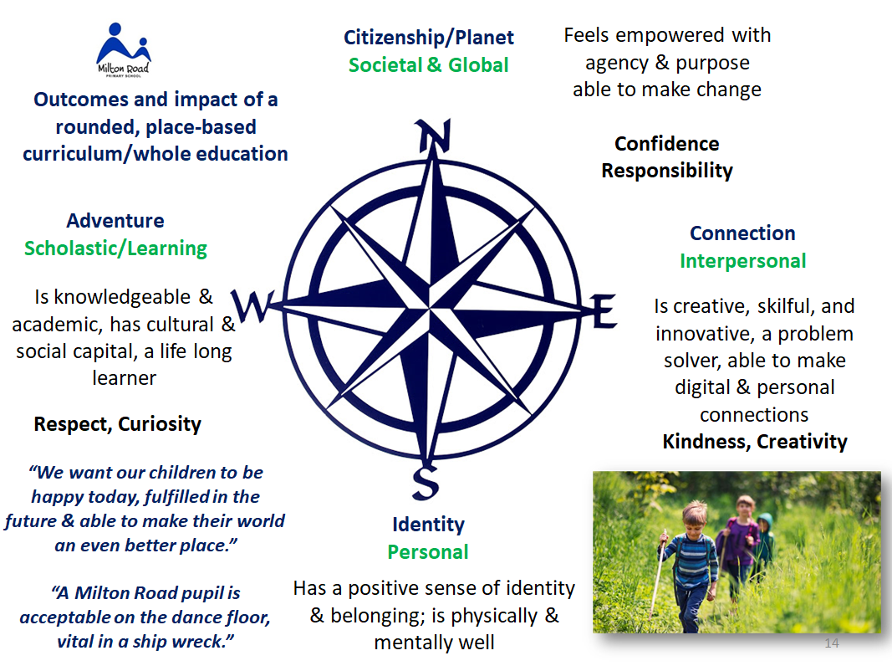
A Holistic Curriculum – A Whole Education
Citizenship
Forest School
Geography & sustainability
Art & Design
Design Technology
Music
Drama
ICT
Music
MFL
Maths
English
Science
History
PSHE, Religious Education, PE & Games

Slide 6
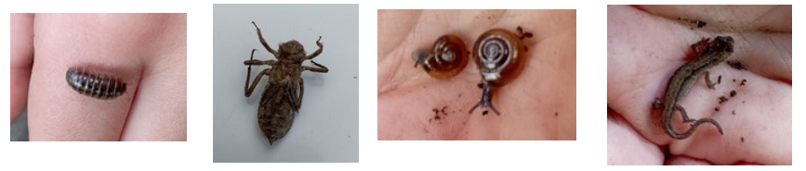
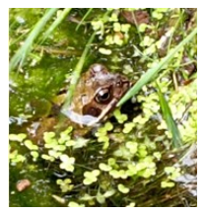



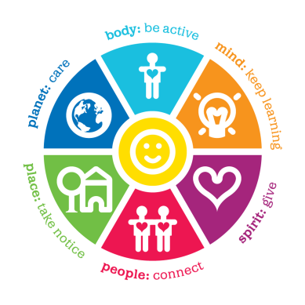
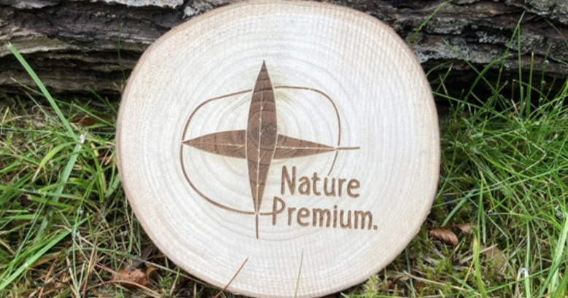
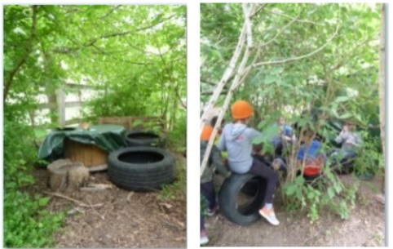
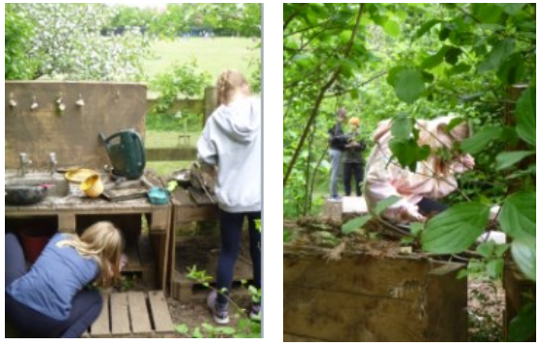
Happy, Healthy Children
PSHE Lessons
The Buddy System
Eco-Council
The Big Think
The Wonder Woods
The Daily Mile
PE/Sports
Dialogic classrooms

Slide 7

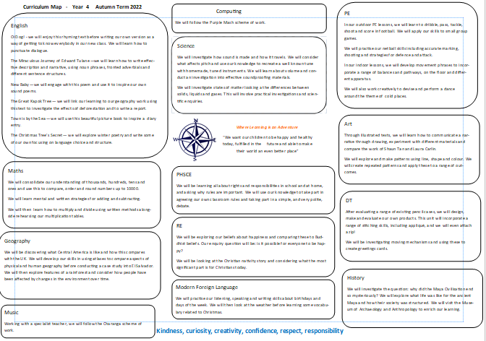
Curriculum Map

Slide 8

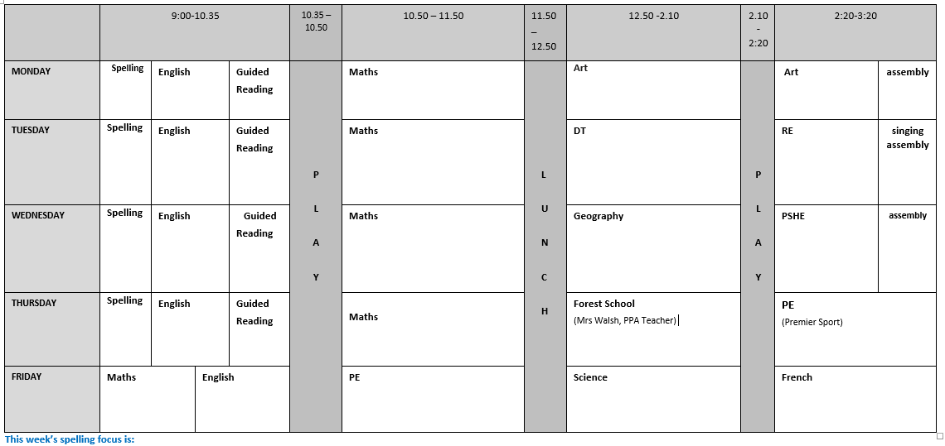
Weekly Timetable

Slide 9
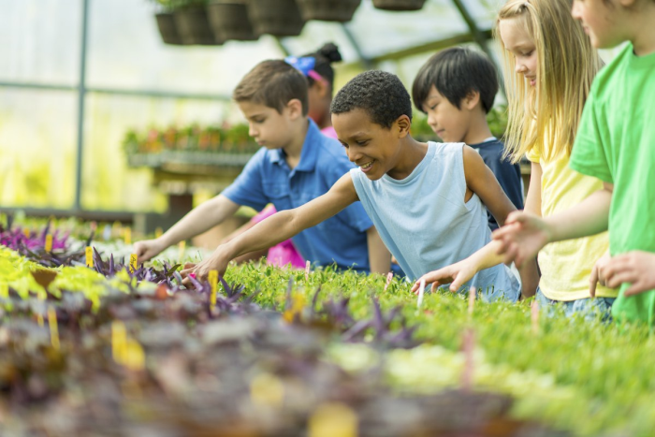
Educational Visits
Museum of Anthropology and Archaeology
Roman Day
Paxton Pits
West Stow

Slide 10
Ready for Learning
Named belongings
Indoor shoes
PE Kits
Water bottles
Reading books

Slide 11
Reading For Pleasure
Encouraging reading environments
The Michael Rosen Library is at the heart of our school

Slide 12
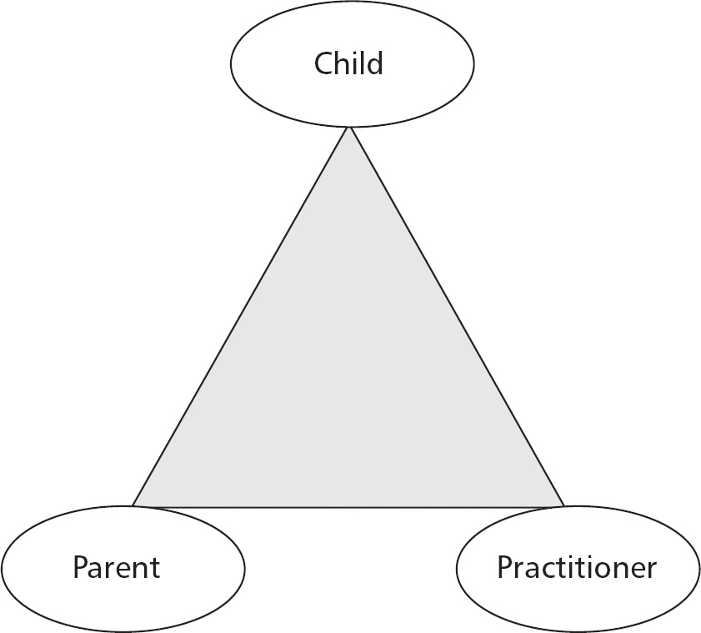
Parents as Partners in Learning
Open communication is key – catch us at the door in the morning or end of the day. For a longer meeting, email the office@miltonroad.cambs.sch.uk
Talk to Us First: The class teacher is always the first post of call with any issue regarding your child. If escalation, or signposting is needed the class teachers will organise this.
Open Friday: An opportunity every Friday (except the first and final Friday of every term) to celebrate your child’s learning, achievement and progress.
Accumulative Termly Report to share with you your child’s progress and termly teacher/parent meetings.
Updates on SeeSaw with photos of the children’s work and learning. Messages might be from either of the Year 4 teachers.
Volunteering in school: educational visits, library, expert speakers, gardening, fund raising
An inclusive weekly newsletter of school events, key information, religious celebrations, as well as activities in the community, please email the office if there is something to add.

Slide 13

Learning at Home
Century
TTRS – Year 4 MTC in the Summer Term
Reading

Slide 14

Thank you for joining us today!

