Slide 1


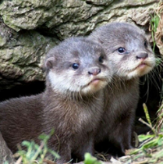
Welcome to Year Two
2M
Dolphins
2R
Otters

Slide 2
Meet the team
2M Dolphins
Mrs Williman
Mrs Reehal
Mr Fisher
Mr Edun
2R Otters
Miss Frost
Mrs Kawula
Mrs Sheikh

Slide 3
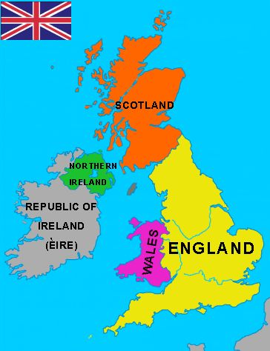
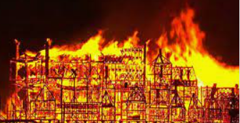
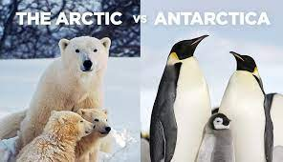
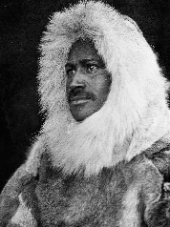
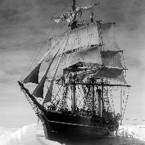
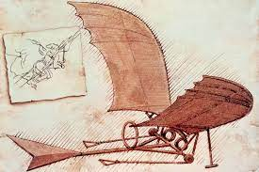

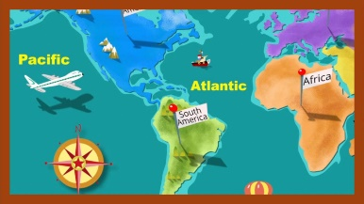
Our Topics
Where in the world are we?
What and where is the UK?
Countries, Capitals, seas and Cambridge
The Great Fire Of London
Living in the freezer! What is it like at The Poles?
Why do explorers travel to the poles?
Includes comparison of Cambridge and Nunavut.
Who are the significant pioneers of flight?
How are we connected to the world? Continents and Oceans Wonders of the World

Slide 4
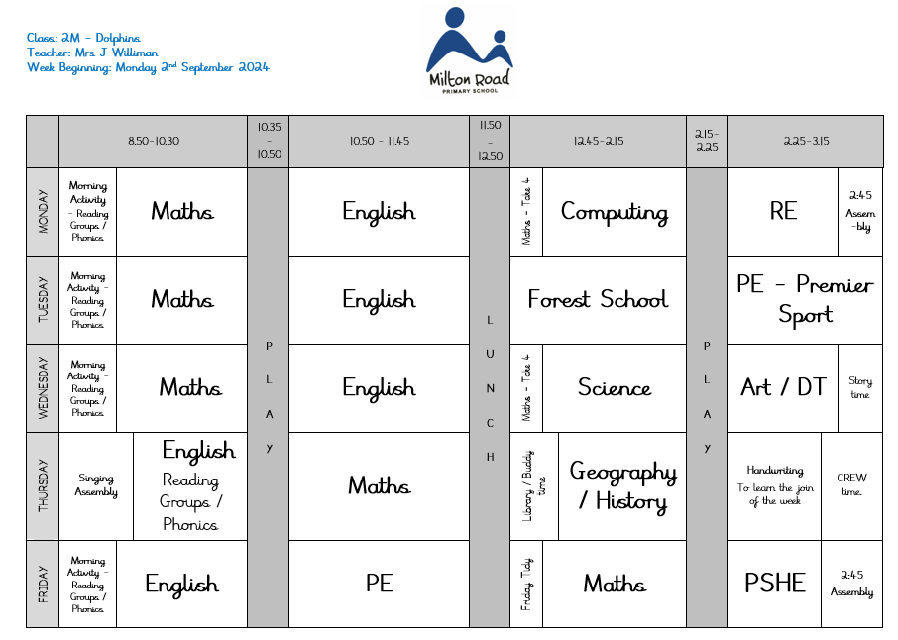
A typical week …

Slide 5
A typical week …
Daily English and Maths
2 hours of PE a week – Tuesdays and Fridays
Weekly Science lessons
Little Wandle reading sessions
‘Foundation subjects’: History, Geography, Music, Art, PSHE, Computing, RE,
Forest School – first half of each term, Tuesday afternoons
Handwriting
CREW time

Slide 6


Slide 7
Phonics and Reading
We will change your child’s reading book(s) once a week.
We will check Reading Record books each time the children are read with – please ensure these books are in school every day!
Library books – changed on Thursdays.
Please encourage your child to discuss any stories they have read – inference / prediction / vocabulary / characters (empathy) / making links to other books or their own experiences.

Slide 8
PE
PE days: Tuesdays and Fridays
PE kit is not optional!
At the moment, the children are required to wear their PE kit from home.
Warm kit and trainers required for outdoor games
Long hair needs to be tied back and earrings removed
Please send a note if your child is not able to do PE

Slide 9



Homework
Home learning tasks to be completed weekly.
Around 15 minutes each week, plus daily reading time.
Closely linked to our learning in school.
Spellings to learn
Homework will either be on Seesaw, or Century (once this is set up for Year Two).

Slide 10
Other important information …
SATs are now non-statutory!
Medical and contact information – please ensure we have up to date information for yourselves and your children.
Please name everything!
Timings – 8:45 to 3:15
Jewellery – stud earrings only, but these must be removed before PE lessons.
We are a nut free school – no exceptions!

Slide 11
Important Dates
Nativity
  Monday 9th and Tuesday 10th December
Educational Visits:
  Great Fire of London workshop – Friday 22nd November
  Cambridge Central Mosque – 21st and 25th January (TBC)
Expert Showcase events:
  Autumn Term – Nativity
  Spring Term – Friday 14th Feb, 9am
  Summer Term – Thursday 15th May 2:30pm
Parent Lunches:
  2M – Tuesday 20th May
  2R – Wednesday 21st May

Slide 12
Other Useful Information
Reading the Newsletters and messages on Seesaw are key!
Open Fridays (3:30-4pm) will begin soon.
Educational Visits – helpers needed please!
Any queries, please contact us via Seesaw, or the school office: office@miltonroad.cambs.sch.uk

