Slide 1

Welcome to Year 1
1M Dragonflies 1R Bumble bees

Slide 2
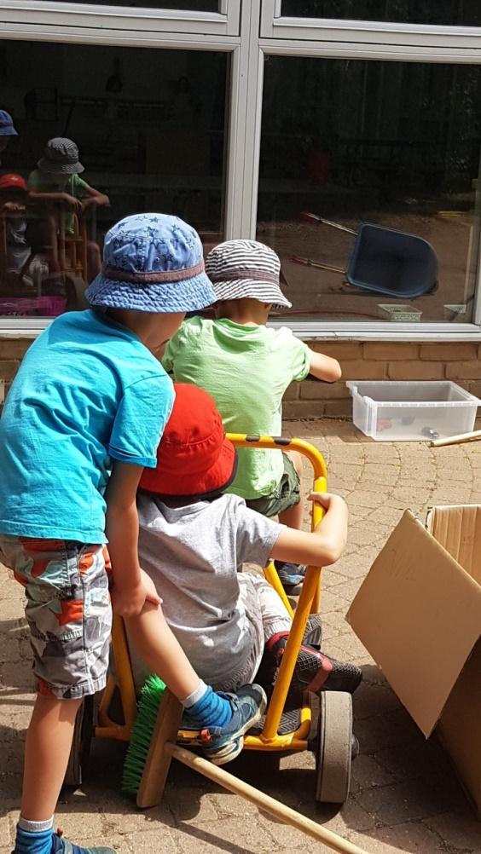

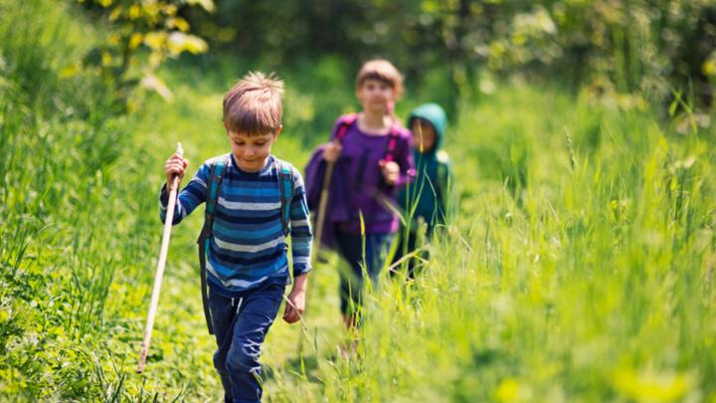
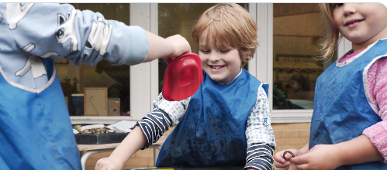
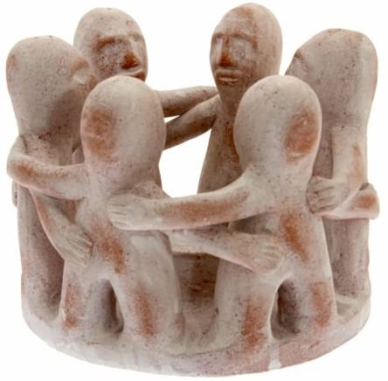
What’s our curriculum purpose?
We want our children to be happy & healthy today, fulfilled in the future and able to make their world an even better place.

Slide 3
We are a Values Based School - Values at the Heart of our Ethos
#WeAreCrew
C – Creativity, Curiosity, Kindness, Confidence, Care, Change making
R – Respect, Responsibility
E – Excellence, Elegance, Empathy
W – Wisdom
“Knowledge is knowing that a tomato is a fruit, wisdom is knowing not to put it in a fruit salad!” Miles Kington

Slide 4

Safety, Well-being, Welfare
The Take Care Agreements to keep everyone safe!
Kind children, trusted adults
Class Agreements

Slide 5

A Holistic Curriculum – A Whole Education
Citizenship
Forest School
Geography & sustainability
Art & Design
Design Technology
Music
Drama
ICT
Music
MFL
Maths
English
Science
History
PSHE, Religious Education, PE & Games

Slide 6
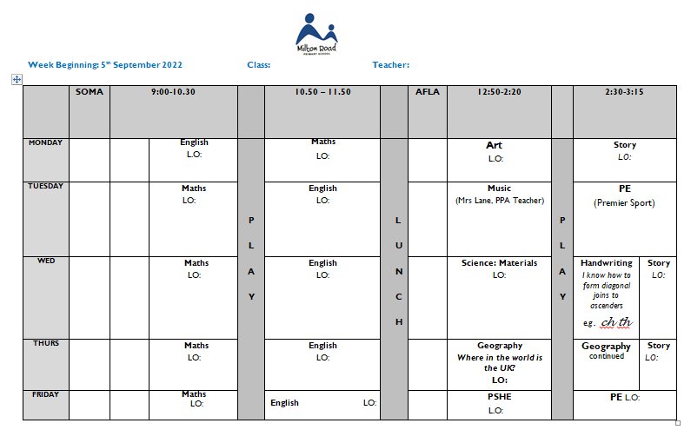
Weekly Timetable

Slide 7
Year 1 must have…
Weather appropriate clothing
Small bag/rucksack
Book bag
One healthy snack in a small named container. (remember no nuts)
Wellies and waterproof clothing for Forest school days. This half term it is on a Wednesday, they will then be sent home at the end of the day.
Named water bottles

Slide 8
Snacks
•The government provides a free fruit/vegetable snack for every child in Key Stage 1 each day.
•You may therefore only need to provide one snack a day. Please ensure that it is a healthy snack such as a piece of fruit or vegetable. Please do not bring in crisps, chocolate or other unhealthy snacks as we are a health promoting school.

Slide 9
Morning Routine
Thank you for helping to encourage independence by helping your child to organise their own water bottles and bag for the day.
Teachers will come to the pod area at 8.45. We would like the children to be seated in the pod having placed their water bottles in the appropriate place having said goodbye to their parents/carers.
Children will always have a specific activity to complete when they come into school.
Classes choose their lunch option as they are being registered. Could you please talk with them about the choices for the day. If they don’t like any of the options then please provide a packed lunch

Slide 10

Phonics
We are continuing to follow Little Wandle Phonics and reading scheme.
Phonic sessions will take place daily. We will be re-visiting phases two and three, before moving onto phase 4 and 5.

Slide 11
Reading For Pleasure
Reading
Children will take part in guided reading sessions in groups three times a week.
There is a greater emphasis on the books being phonetically decodable.
The children will have the same book in each of the three sessions and carry out structured tasks.
This book will then be sent home on a Friday night.
Please ensure that the book is returned the following Wednesday!
They will also be allowed to bring home a library book.
Please note that for the first 3 weeks, the children will be taking home a book from the same level that they were on in Reception so these may be repeats from last year.

Slide 12
PE
Children will be participating in P.E. activities on a Wednesday afternoon. These sessions are run by Premier Sport and the children really look forward to them.
They will have an additional PE session on Monday afternoon.
Children should come dressed in their P.E. kits on those days.
For PE children need:
Blue Milton Road T Shirt
Blue shorts
Trainers
No earrings are to be worn on these days and long hair should be tied back.

Slide 13
End of the day
At the end of the day the children collect their property and line up in the class pod area. Teachers will send children to their collectors.
If you need to speak to the teacher, could you please wait until all the children have gone.
Please inform us if your child is being collected by a different adult, you can either contact the office or message us on Seesaw.

Slide 14
Contact and Medical
Please ensure that the office has an up date record of all contact and medical details.

Slide 15
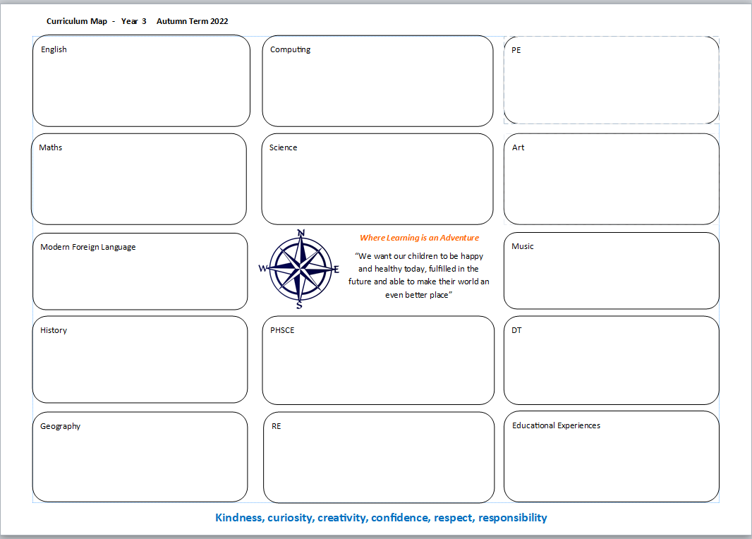
Curriculum Map

Slide 16
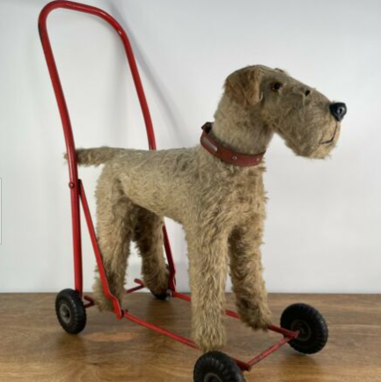
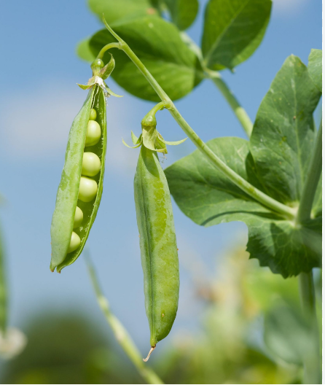
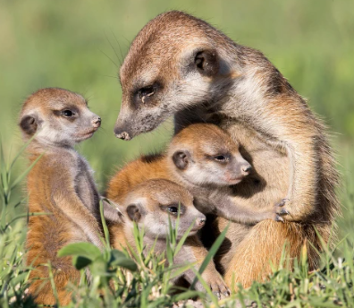
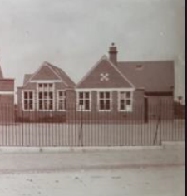
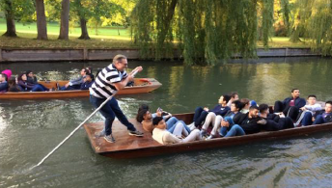
Topics
Toys
History of our school
Animals and Zambia
Transport in Cambridge
Growing

Slide 17
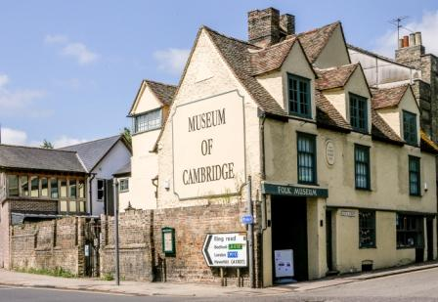
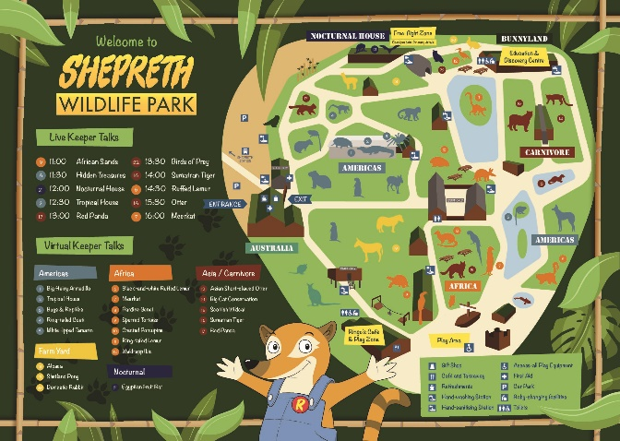
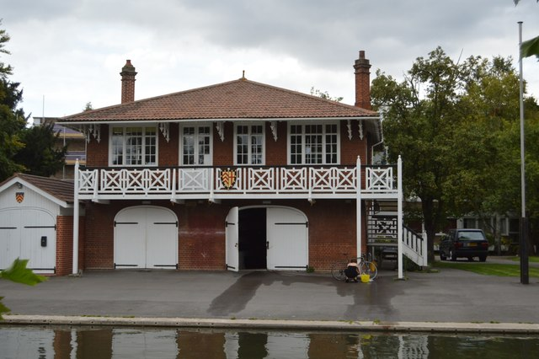
Educational Visits
The Museum of Cambridge
Shepreth Wildlife Park
Clare College Boat House

Slide 18



Learning Expectations
Relationships Matter
Classroom Routines, responsibility and co-regulation
Be Prepared
There are standards, there are high standards, and there are Milton Road standards
Excellence does not happen by chance!
The divine is in the detail

Slide 19
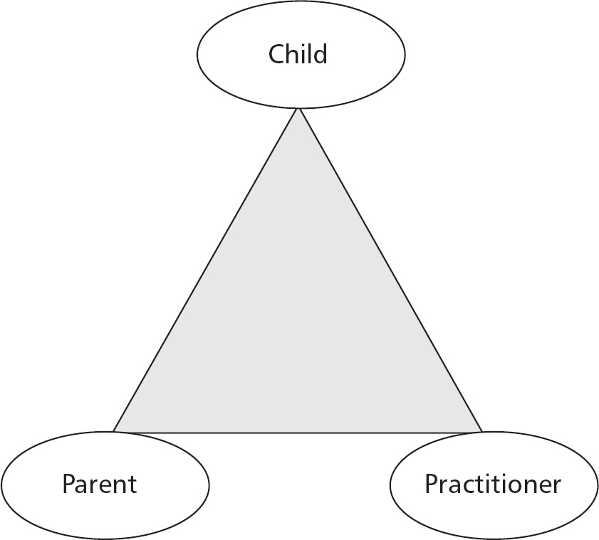
Parents as Partners in Learning
“A parent’s active involvement in their child’s education is the most significant impact on a child’s learning and behaviour.” Prof Janet Goodall
Open communication is key – catch us at the door in the morning or end of the day. For a longer meeting, email the office@miltonroad.cambs.sch.uk
Talk to Us First: The class teacher is always the first post of call with any issue regarding your child. If escalation, or signposting is needed the class teachers will organise this.
Making the curriculum transparent: You will receive a Curriculum Map for the Term as well as a weekly timetable with the objectives so that you can support your child’s learning at home
Expert showcase – towards the end of the term the children will invite parents/carers to attend their Expert Showcase. An opportunity for the children to articulate their learning and answer questions.
Open Friday: An opportunity every Friday (except the first and final Friday of every term) to celebrate your child’s learning, achievement and progress.
Accumulative Termly Report to share with you your child’s progress and termly teacher/parent meetings. Please come to the first parent/teacher meetings prepared to let you know of any interests, concerns, attitudes and motivations that your child has.
Updates on SeeSaw with photos of the children’s work and learning.
Volunteering in school: educational visits, library, expert speakers, gardening, fund raising
Home learning expectations: Reading with your child ‘little and often’, phonics support work.
An inclusive weekly newsletter of school events, key information, religious celebrations, as well as activities in the community, please email the office if there is something to add.
Parents to sign up to Facebook and/or Linkedin and follow Milton Road Primary School

Slide 20

Thank you for joining us today!

