Slide 1
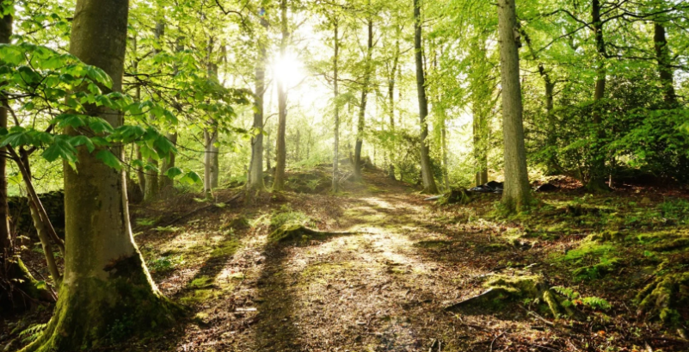
Milton Road Forest School

Slide 2
So what is Forest School?
Let’s take a look at the history

Slide 3
A potted history of Forest Schools
Forest School developed in Sweden in late 1950s by a retired soldier.
The idea was taken and developed in Denmark in the 1980s as a solution to the lack of buildings for nursery places.
In 1993 a group of nursery nurses at Bridgwater College, Somerset, visited Denmark to look at the pre-school system. The open air culture (‘friluftsliv’) is seen as a way of life in Scandinavia and permeates early years education.
Bridgwater College implement the Forest School ethos in the college creche.
In 1995 the first BTech in Forest School is offered to Early Years Practitioners.
From 2000, Wales and several LA’s in England took up Forest School.The first training material is written and delivered in Wales.
In 2012 the Forest School Association (FSA) is formed as a professional body to represent good practise and link Forest School practitioners around the country.

Slide 4
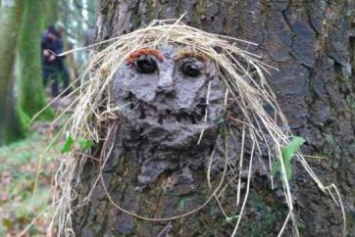
Ethos
A fundamental respect for children and young people and for their capacity to instigate, test and maintain curiosity in the world around them.
The belief in a child's right to play; the right to access the outdoors (and in particular a woodland environment)
The right to access risk and the vibrant reality of the natural world
The right to experience a healthy range of emotions, through all the challenges of social interaction
To build a resilience that will enable continued
and creative engagement with their peers
and their potential.

Slide 5
Underpinning Forest School are its 6 principles
1. Successful Forest Schools require frequent and regular sessions over a long term. This is to enable a child to have quality time to adjust and begin developing new skills and relationships.
2. The woodland environment in which the Forest School is set needs to be maintained and risk managed. The Forest School will use the natural resources to create a safe and fun learning environment.
3. Holistic development is fostering resilient, confident, independent and creative learners.

Slide 6
4. Forest School needs to provide opportunities for the children to take appropriate risks.
5. Practitioners need up to date qualifications and to maintain their professional development. They are required to have all their safety qualifications including Fire and Tool Safety and First Aid.
6. Forest School uses a learner-centred process using planning, adapting, observing and reviewing. These are all integral elements of Forest School as it is a child-led learning environment.

Slide 7
Let’s see it in action!
https://www.youtube.com/watch?feature=youtu.be&v=Jkiij9dJfcw&app=desktop

Slide 8
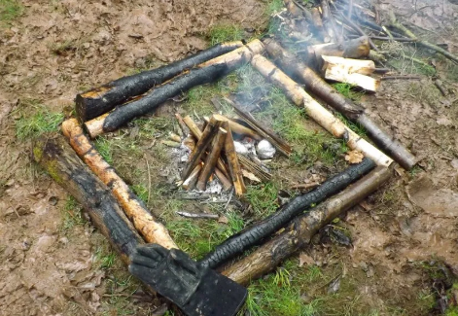
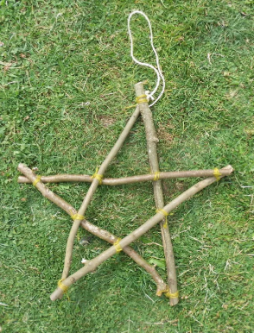
How will it look at Milton Road?
Afternoons will be dedicated to Forest School and Reception through to Year 6 will be taking part on a ½ termly basis.
A typical session will encompass;
A perimeter walk of the area to observe any changes to the environment
All gathering around the fire circle for briefing on the session
An adult guided activity; woodland crafts, tool handling, fire lighting, outdoor cooking, tree climbing, foraging, knot work.
The children then have an opportunity to engage in a self lead activity; mud station, den building, moving parts etc.
Tidy up
Snack and drink in the fire circle
Reflection time
Depart
It is worth remembering that this is Forest School NOT
outdoor learning!

Slide 9
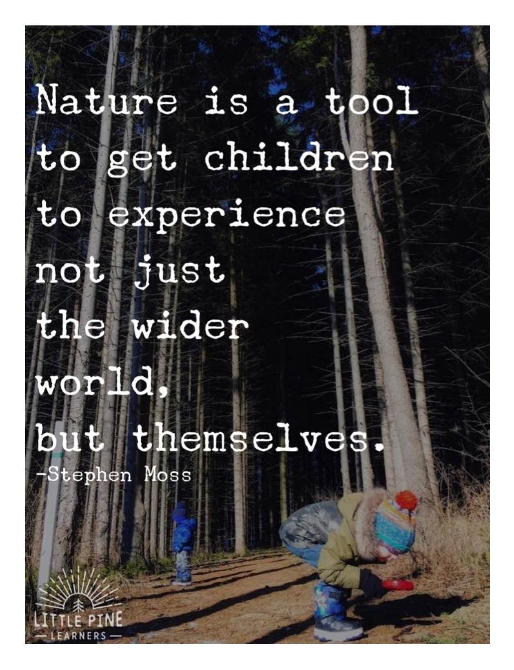


Slide 10
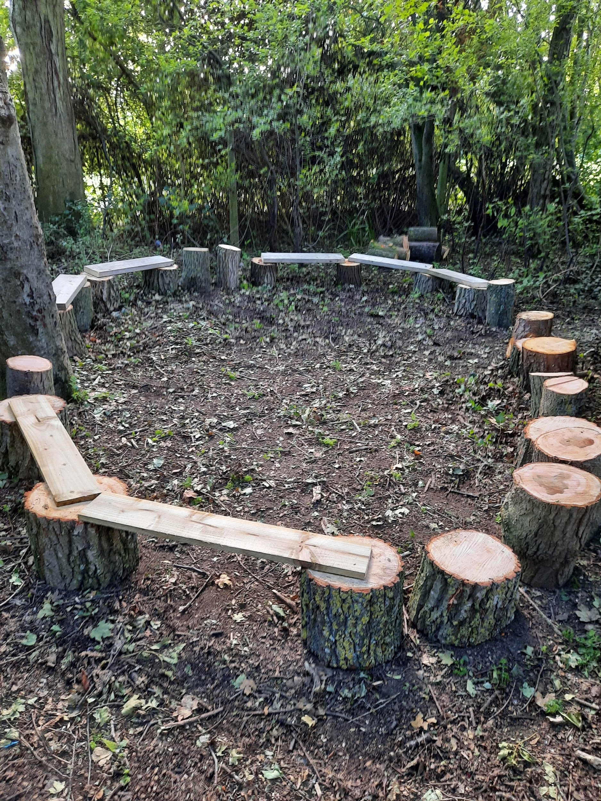
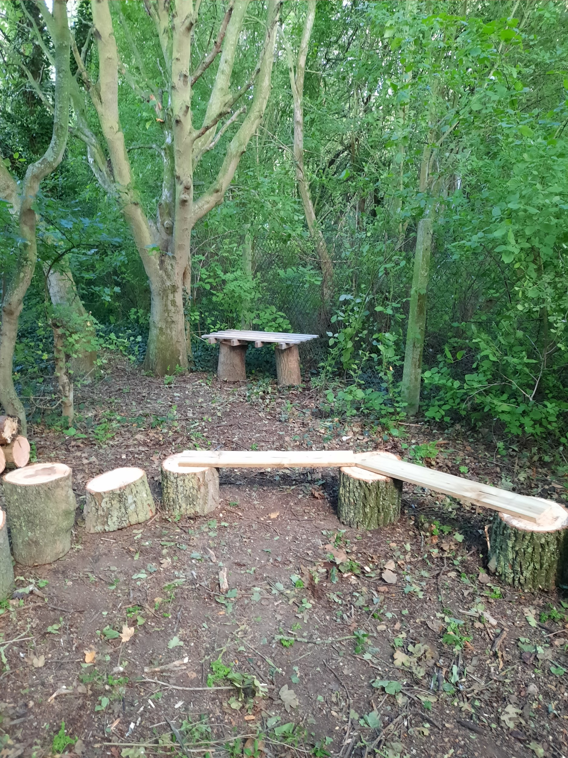
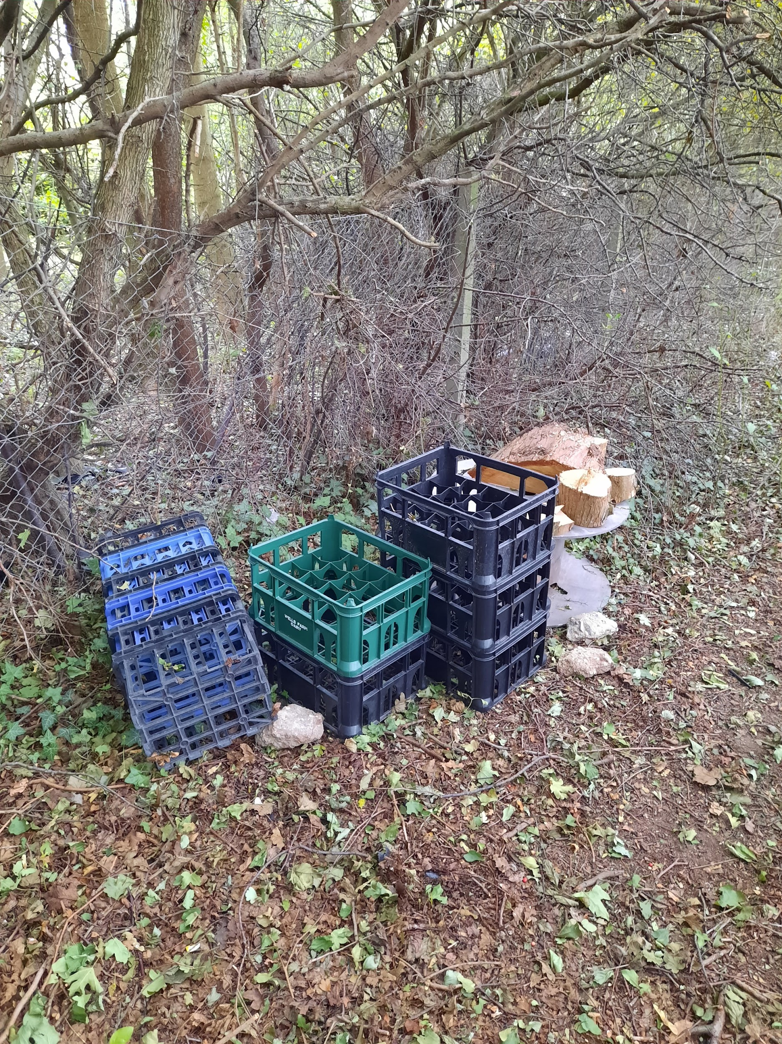
Our Forest School area is taking shape!
An example fire circle
An example fire circle and hygiene station
The beginnings of the moving parts station

Slide 11
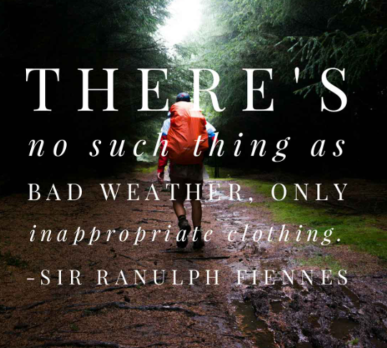
My favourite quote...

