Slide 1
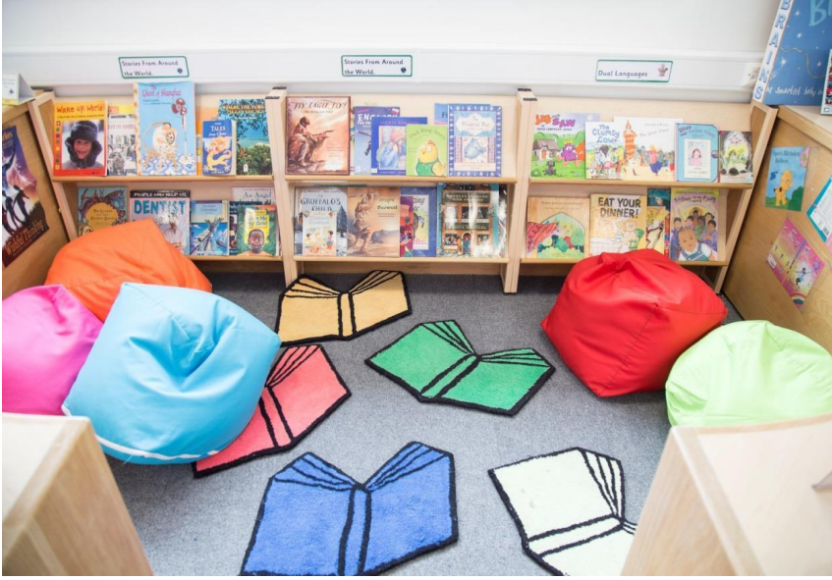
Session objectives:
To explore English at MRPS
To share long term planning and progression documents.
To explore the updated Reading Framework 2023
self evaluation & reading actions.
To signpost teachers to Reading for Pleasure research - website
Nikki – LW
Renee – KS2
Research - Reading for pleasure/updated reading framework
What’s next? Theory to practice

Slide 2

Reading is good - can we improve reading for pleasure?
It would be good to know and understand steps in progression in writing.
You said…
Reading records needs to be consistent
Big write is good. Creates a portfolio of high quality writing. Shows progress.
Guided reading – do we need all the groups?
Is writing inspiring enough? Are the children writing at GD? How can we get them there?
Inconsistency in handwriting expectations:
LJ 3x p/w
Interventions?
We need an approach to whole school writing, high quality texts to bring the writing to life – write for pleasure.
CPD teaching spelling:
3x p/w Essential spelling
Develop pupils vocabulary – Oracy project
We need variety in English. Drama, T4W games…

Slide 3
Expectations in English vs What does it look like at MRPS?
English Area | Expectation | Support
Early reading and phonics | daily Little Wandle – EY, Y1, Y2 share a story | SEND/keep up programme used across school – fidelity! Reading 3x p/w every child reads 3x Opportunity to develop fluency
EY/ KS1 Writing | daily opportunities to write EY provision – 1p/w Daily provisions 1 main writing p/w – writng daily with LW Challenges and enhancements daily text based English lessons
EY KS1 Spelling/Handwriting | LW spelling - progression compliments LW phonics Letter join? | LW G charts in class on tables What to do in year two – LW https://www.littlewandlelettersandsounds.org.uk/resources/my-letters-and-sounds/weekly-reading-and-phonics/rapid-catch-up/
KS2 Reading | 3-4x p/w? Whole class ? 1 lesson p/w fluency? | Reading Recovery K2 y3 Nessy – Data Small groups Geings fluency
KS2 Writing | Daily text based English lessons Genre specific? Cross curricular opps?
KS2 Spelling/Handwriting | Essential spelling 3x p/w Letter join 3x p/w? | Year 6 spellings? Using EP under review

Slide 4
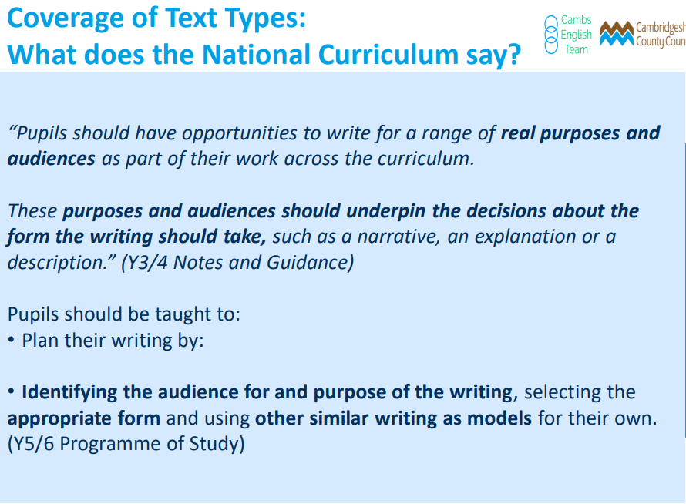
Notes:
Long term plan – add in text types and books
Not a reading spine
Expectations
EYFS – LW
Y2 – LW spelling follow on
Y3 – Catch up interventions
Y4-6

Slide 5
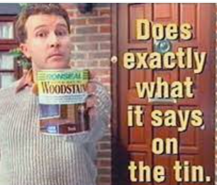
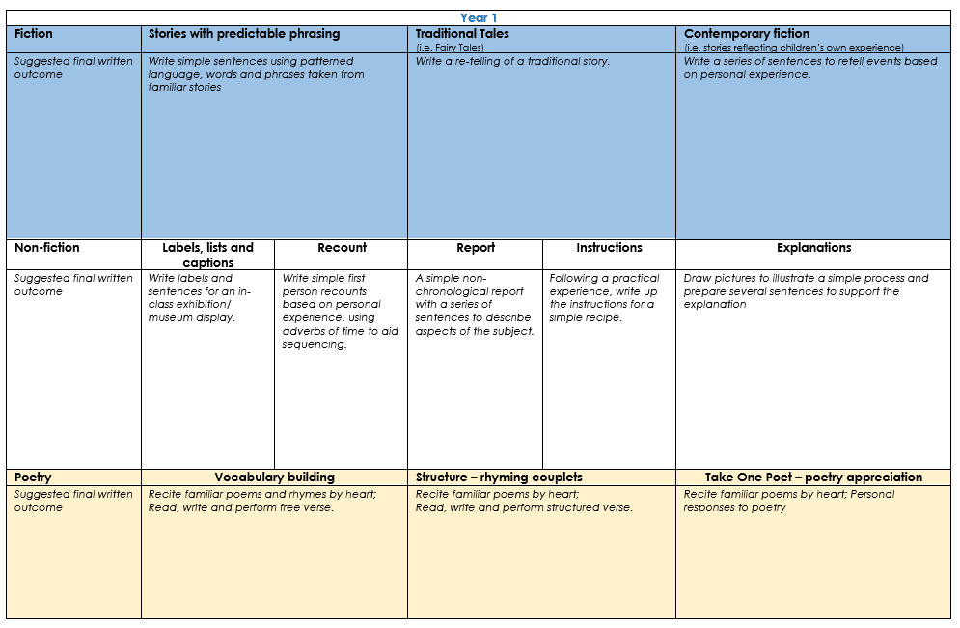
Activity
Notes:
Long term plan – add in text types and books
Not a reading spine
Expectations
EYFS – LW
Y2 – LW spelling follow on
Y3 – Catch up interventions
Y4-6

Slide 6
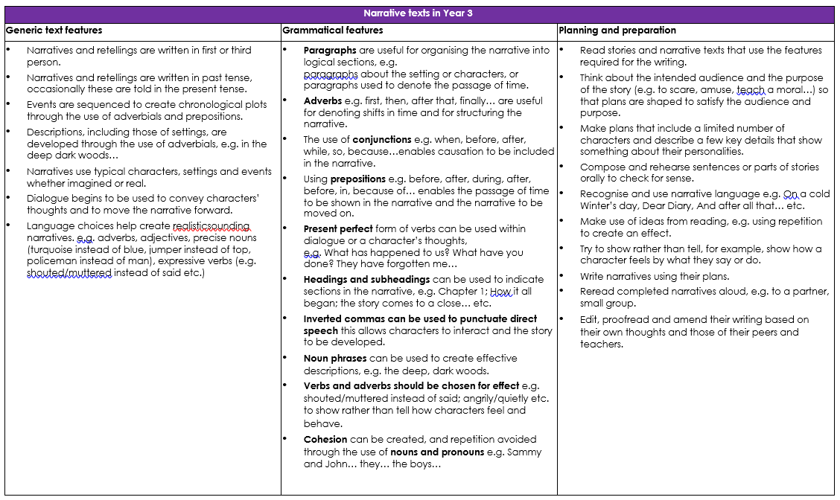
It would be good to know and understand steps in progression in writing.
The 2014 National Curriculum emphasises grammar. Grammar has its own statutory appendix in the curriculum document (signalling its significance) and we know from the TAFs that the application of grammatical forms is a significant aspect of the assessment process.
Notes:
he 2014 National Curriculum does not require children to produce texts that fulfil the structural requirements of the genres taught through the National Strategies approach.
It does though, stipulate that children write for an audience and intended purpose. My position is that children still need to write to inform, persuade, explain etc
It’s a document that supports the teaching of the grammar outlined in the National Curriculum so that it’s used authentically to meet the purpose and audience of a piece of writing
matched the National Curriculum grammar objectives to each writing purpose so that you can see where and how they can be taught authentically.

Slide 7

Reading Deep Dive – Thursday 16th November
Liz will see:
EY/KS1 Small groups reading
Phonics lessons
Year 2 phonics/spelling depending on where children are
Time with RE and NS –mock deep dive questions
Reading in KS2 – Y4-impact of reading fluency
Y3/Y1 –
Rapid catch up groups in KS2 – focus: consistency to approach/fidelity to LW ‘keep up’ programme
Reading environments

Slide 8
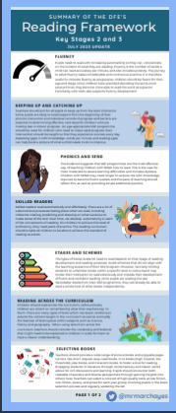

Slide 9
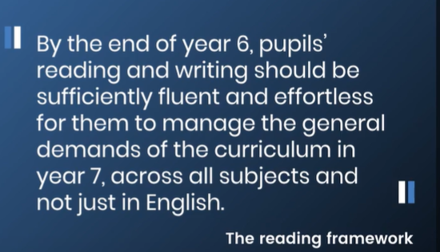
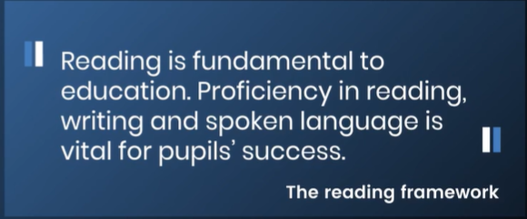
Aims…
The guidance begins by setting out the social, cultural and economic importance of reading before outlining a conceptual model of it.

Slide 10
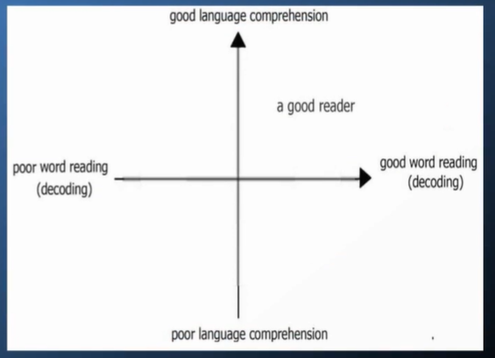
Why does reading matter?
Slower
Develops over time
Experiences
Small window
Rapid progress for reading words in KEY
Phonics
DFE ambition- “all children to be reading by the end of YEAR one, or at the very latest, end of year two.”
Access the curriculum
Content more challenging
Rapid agenda to get chn to understand vocab
Gough and Tunmer’s original description of the Simple View of Reading 1986

Slide 11
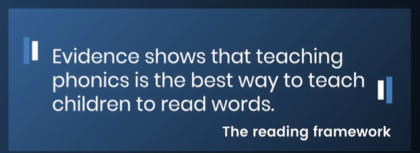
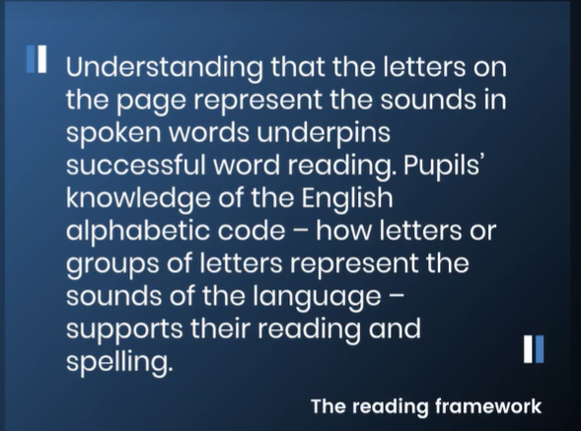
Early reading
Notes:
RF is not statutory or legal framework but gives us best practice guidance links with stat docu and what Ofsted are looking for
Developing talk
Importance of poetry and rhyme -

Slide 12
Aims
To help schools to meet the expectations set out in the Early Years Foundation Stage (EYFS) statutory framework and the national curriculum. It aligns with Ofsted’s Education Inspection Framework.
Importance of talk, stories, devolping voacb in EY
Guidance about how reading should be taught in primary schools through systematic phonics, talk, stories time, poetry, reading environment
Set out some of the research underpinning the importance of talk, stories and systematic synthetic phonics (SSP) in Reception.
The importance of ‘fidelity to the programme’ in phonics.
DfE’s evidence-informed position on the best way to teach reading
Support schools to evaluate their teaching of reading from Reception to year 9 and to identify how to improve provision
Provide practical support for high-quality teaching of SSP, fluency and comprehension, including assessment, developing vocabulary,
Importance of systematic phonics teaching for older pupils who are at risk of failing to learn to read because they cannot decode/SEND/find it difficult to learn to read
Support schools in motivating pupils to develop a love of reading
reading for pleasure -
Support schools working with parents to help their children learn to read.

Slide 13


Slide 14
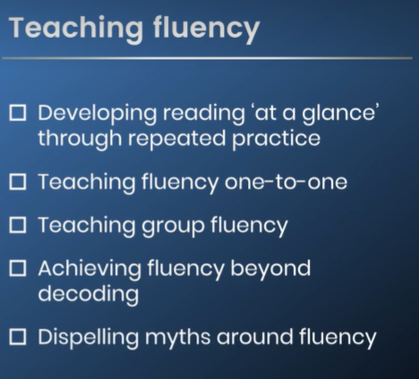
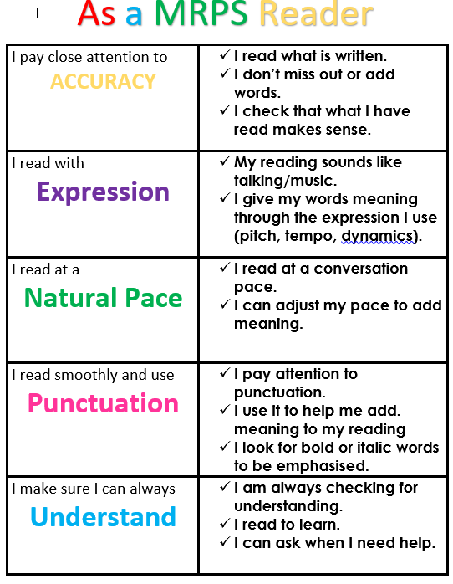
Audit please

Slide 15
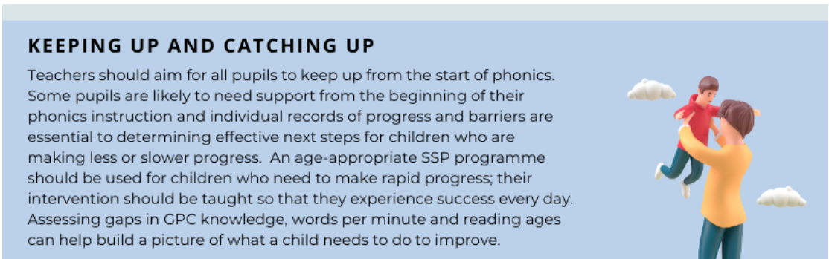

Slide 16


Slide 17
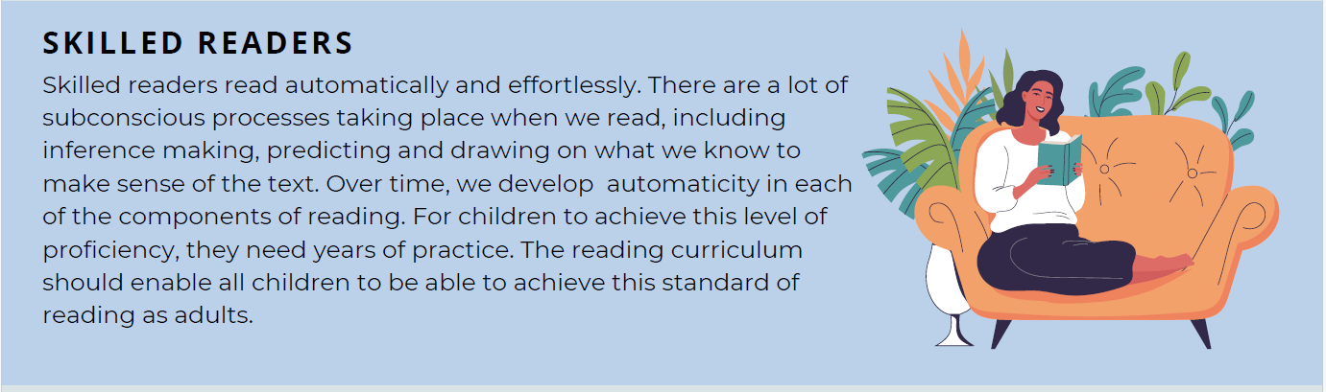

Slide 18
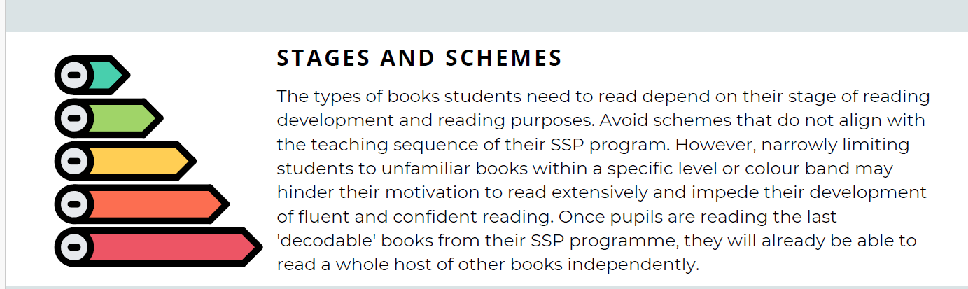

Slide 19


Slide 20


Slide 21


Slide 22


Slide 23
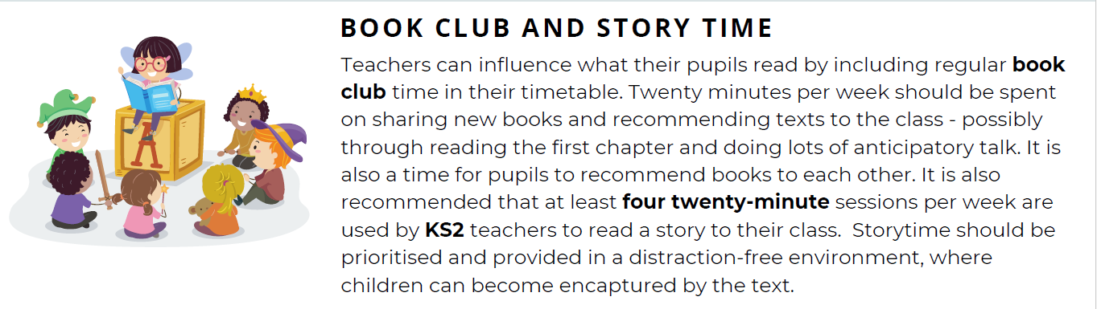

Slide 24
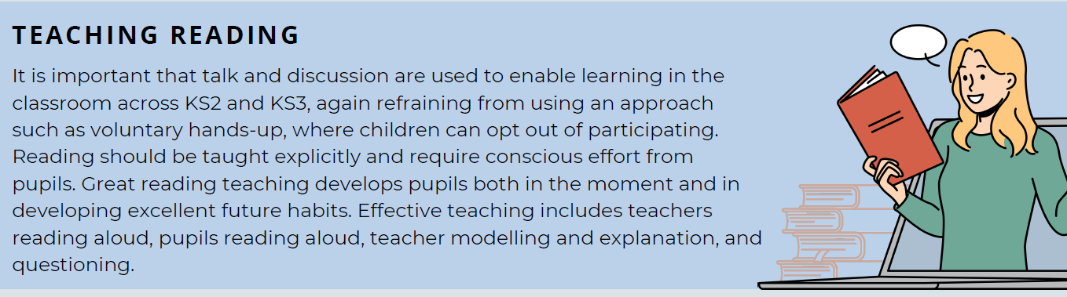

Slide 25
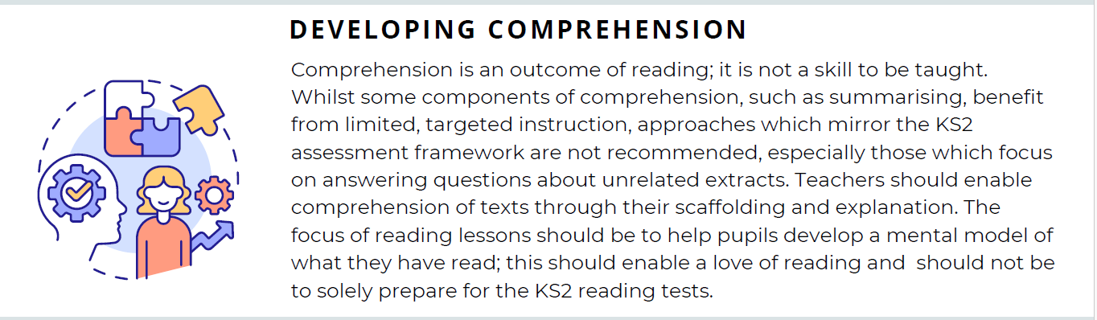

Slide 26
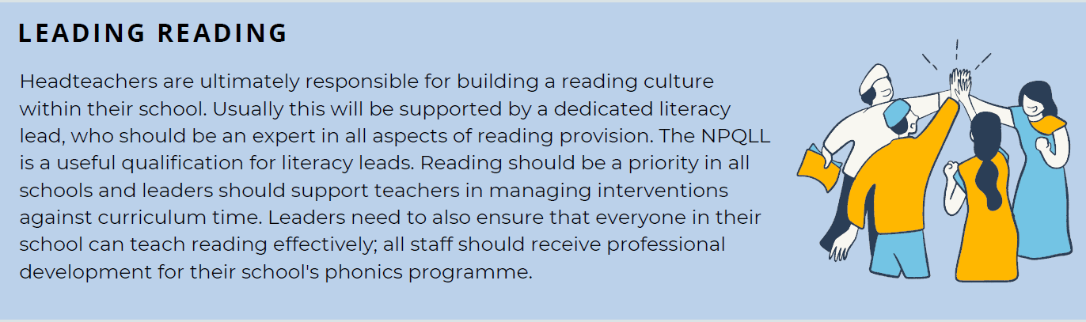

Slide 27
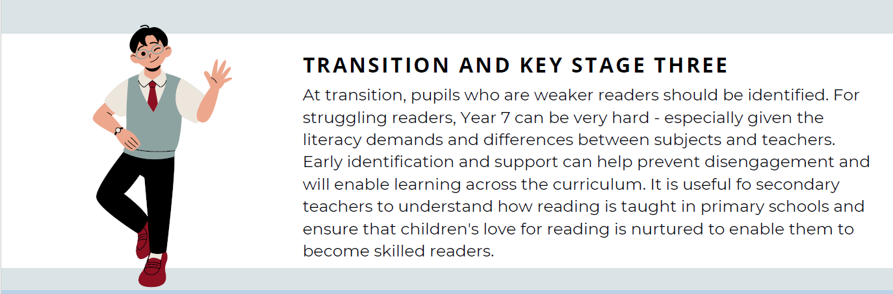

Slide 28

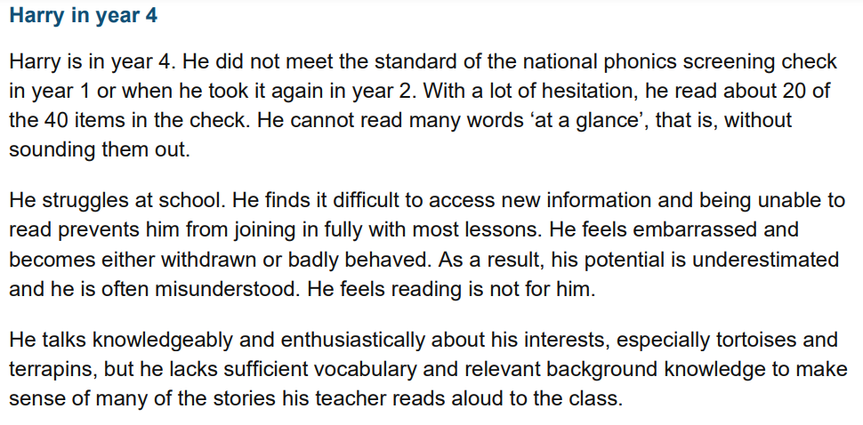
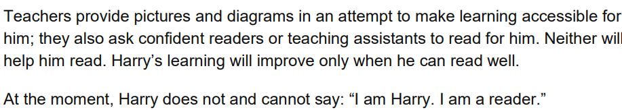
Case study
Next steps for Harry
Assess his gaps using the school SSP
• filling in any gaps in his GPC knowledge through the school’s phonics programme
• reading the GPCs he has been taught
• decoding unfamiliar words with the GPCs he knows
• reading familiar words ‘at a glance’
• reading books that use the GPCs he has learnt. In addition, he needs to listen to stories read aloud in story times. And, in due course, he will need to learn everything that Amina (below) needs to learn

Slide 29
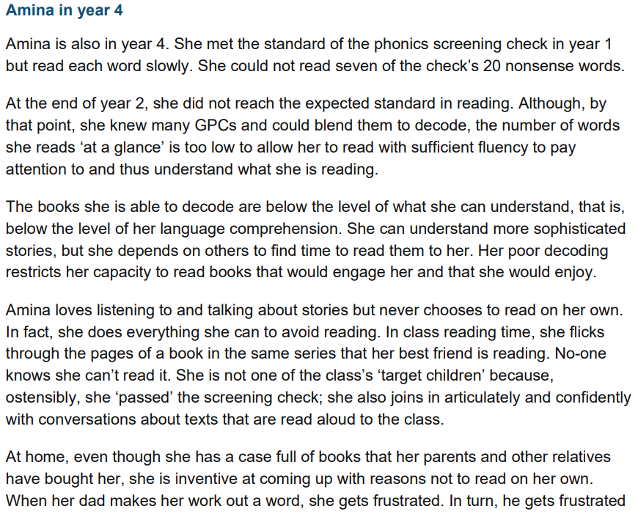
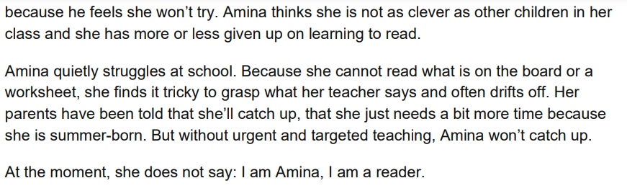
Case study
• filling in any gaps in her GPC knowledge through the school’s phonic programme
• decoding unfamiliar words, both single and multi-syllabic, containing GPCs she has learnt
• reading familiar words ‘at a glance’
• reading lively, well written, phonically decodable books containing the GPCs she knows – right to the last stages of the school’s phonic programme
• re-reading these books to develop fluency
• reading familiar books the teacher has read aloud

Slide 30

Research – on website
https://ourfp.org/
https://www.bl.uk/childrens-books/activities/creative-campaigns?utm_medium=email&utm_source=govdelivery
https://www.sevenstories.org.uk/
Reflect on reading in your class.
Complete ONE audit and research. Set achievable targets.
Identify pupils who need support –PPM.
?
Continue to track fluency.

Slide 31
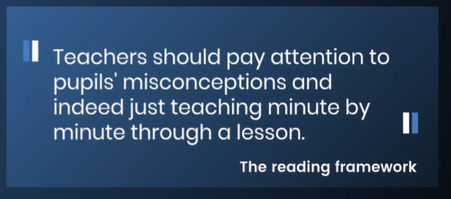
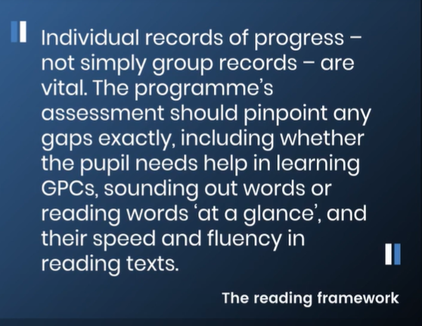
Assessment
Data – lowest 20%
Summative assessment are about:
• providing teachers with information about what each pupil has learnt in a given period
• providing leaders with information about which pupils might benefit from additional support.
What is important is that teachers and leaders are clear about ‘what they are drawing from their data and how that informs their curriculum and teaching’.
Pupils new to the school should be assessed immediately on arrival.
Notes:
Revisiting – lets chck again
Repeat phrases
Explain unfamiliar words
Bring those lacking attention
Use your TA as a co-pilot – helps to inform at point of learning
How do you assess - do you use the SSP ass’t resources
Reading record clear consistent feedback to families

