Slide 1

Confidentiality Policy
Please be assured I have no concerns, but it is good practice to revisit.

Slide 2
Scenarios What’s the right thing to do?
A Teacher emails the Head with concerns about a child’s behaviour. The parent finds out about it and demands that they see the email. Do they have the right?
You’ve been to the local park at the weekend with your own children and have seen two young pupils from the school without their parents hanging out with a group of much older teens.
A Staff WattsApp Group is used to complain/vent about the behaviour of a specific child.

Slide 3
Scenarios What’s the right thing to do?
A colleague repeatedly puts a chair on a table to put up displays. You know this is not safe and against school policy. The colleague is senior to you and asks you to keep it quiet.
An Assistant Teacher, Teacher and SENCo are talking about a pupil’s educational needs by the photocopier.
A Teacher is working on the train, and opening up logs to respond to CPOMS.

Slide 4

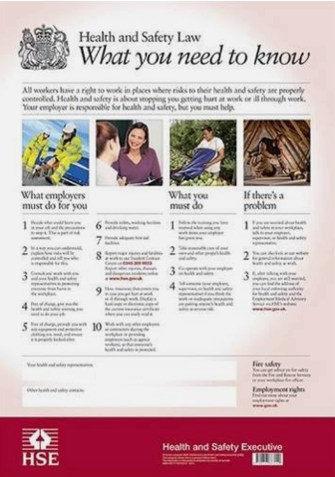
Whistleblowing & Health and Safety

Slide 5

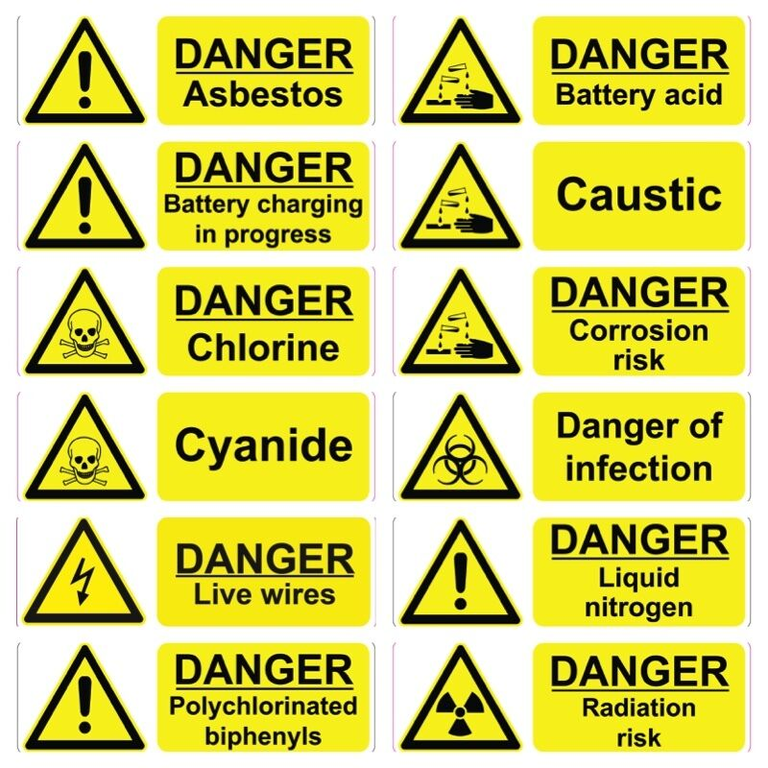

Yellow Triangle

Slide 6
Safety First, Safety Always!
Safety
First!
Safety Always!

Slide 7
Teaching Assistants’ Standards
Teaching assistants should uphold public trust in the education profession by:
Having proper and professional regard for the ethos, policies and practices of the school in which they work as professional members of staff.
Demonstrating positive attitudes, values and behaviours to develop and sustain effective relationships with the school community.

Slide 8
Teachers’ Standards
A teacher is expected to demonstrate consistently high standards of personal and professional conduct. The following statements define the behaviour and attitudes which set the required standard for conduct throughout a teacher’s career.
Teachers uphold public trust in the profession and maintain high standards of ethics and behaviour, within and outside school

Slide 9
What is a breach of confidentiality?
In short, a confidentiality breach is the disclosure of information to someone without the consent of the person who owns it. In other words, failing to respect a person's privacy or the confidence in which they gave the information or data to you, by passing it onto someone else.

Slide 10
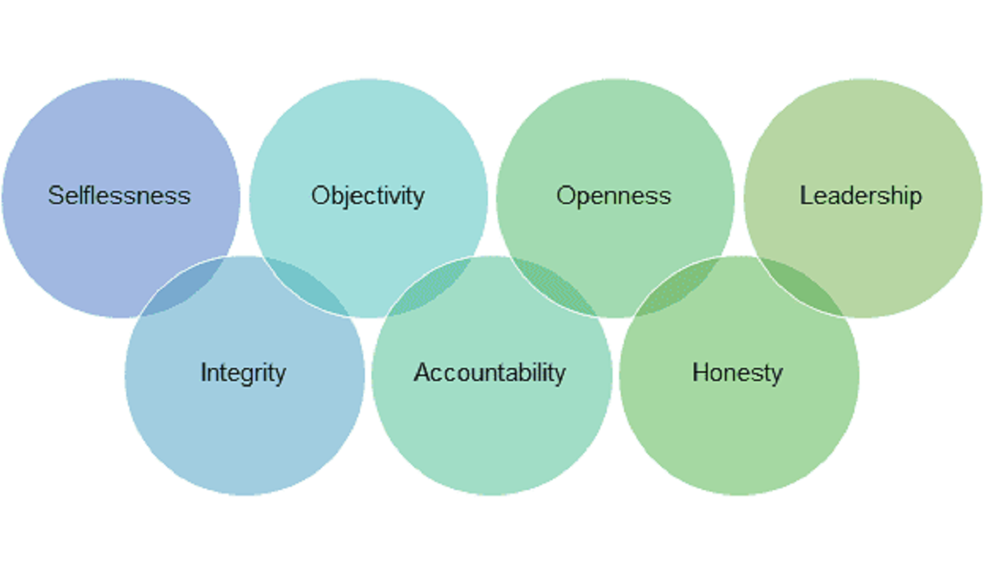
A Highly Professional Workforce
The Confidentiality Policy is one of a number of policies in the school that guide and support our professional practice and help to uphold the integrity of our school and the public’s trust.
The Nolan Principles
Standards for those working in Public Life

